Slide 1



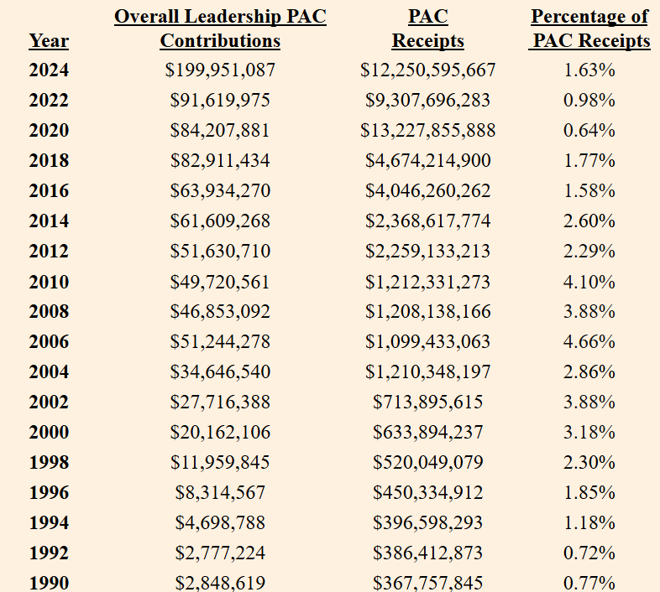

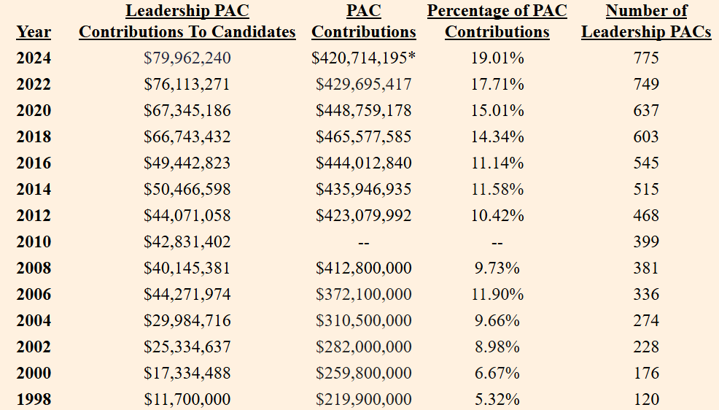
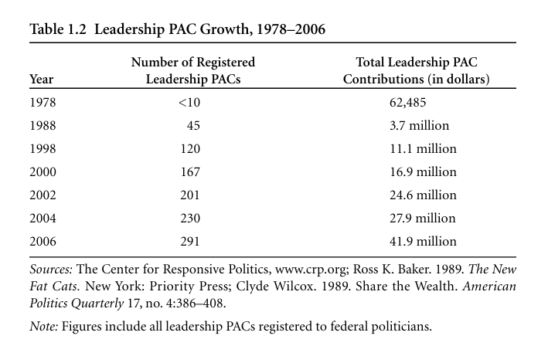

Leadership PACs Throughout the Years
Jacob D. Pritchard | jpritch7@gmu.edu
Schar School of Policy and Government | George Mason University
RESEARCH QUESTION/
HYPOTHESIS
“How have Leadership PACs expanded since their establishment in 1978?”
ABSTRACT
This research seeks to chart the evolution of various metrics associated with Leadership PACs since their inception in 1978. It directly compares various forms of Leadership PAC spending as a proportion of overall PAC spending, overall election spending and overall election contributions. It also seeks to chart the number in operational Leadership PACs in each cycle.
VISUAL DISPLAY:
PICTURE/MAP/GRAPH/
DIAGRAM/QUOTE
INTRODUCTION
In her upcoming book “Social Capitol: How Legislators Build Political Capital in the Congress," Dr. Jennifer Victor charts the rise of political power in Congress. One primary way this political power is accrued is through member-to-member campaign contributions. Essentially, members curry favor with their allies with fiscal contributions – favor that is eventually translated into political power. The preferred mechanism by which members contribute to one another is through their Leadership PACs.
Marian Currinder, in her 2018 book “Money in the House: Campaign Funds and Congressional Party Politics” presents a table (Figure 1) that displayed two columns of information: The dollar amount Leadership PACs contributed to Congressional candidates and the number of operational Leadership PACs in any given cycle. Using this table as a basis, this research had two primary goals: expand this table to the present day and to see how Leadership PAC spending has grown relative to other forms of political spending.
VISUAL DISPLAY:
PICTURE/MAP/GRAPH/
DIAGRAM/QUOTE
Figure 2. Overall Leadership PAC Contributions compared to Overall PAC Receipts.
METHODOLOGY / PROCESS
Data were compiled from various online sources. Proper navigation of several Federal Election Commission databases, particularly those containing press releases, aided in uncovering and compiling information related to PAC expenditures. Furthermore, OpenSecrets was used to derive information related to Leadership PAC activity. Published works, such as books, were used to compile segments of the data, particularly prior to 1998 where digital information on the topic is scarce.
Figure 3. Leadership PAC Contributions to Candidates compared to Overall PAC Contributions.
CONCLUSIONS
This researches findings illuminate the increasing importance of Leadership PACs in building political capital and maintaining Congressional relationships. Congressional power is increasingly wrought through financial contributions dispersed via Leadership PACs, and this research demonstrates the scope of that political evolution.
VISUAL DISPLAY:
PICTURE/MAP/GRAPH/
DIAGRAM/QUOTE
RESULTS / DATA / EVIDENCE
Overall Leadership PAC contributions, as well as Leadership PAC contributions to candidates, have experienced extraordinary growth since 1978. In 1978, Leadership PAC contributions made up 0.02% of overall PAC contributions. In 2024, they made up 19% -- nearly one-fifth-- of PAC contributions. Leadership PACs have also greatly expanded in number, with nearly all candidates – incumbent or otherwise – connected to one in some form. Information about the number of operational Leadership PACs prior to 1998 remains sparce, an area for future research.
ACKNOWLEDGEMENTS
Thank you to Dr. Jennifer Victor for her guidance, encouragement and reliability throughout the completion of this project. Thank you to my lab team members who fostered a supportive and cooperative academic environment throughout the semester.
REFERENCES:
Figure 1. Marian Currinder, “Money in the House: Campaign Funds and Congressional Politics,” Table 1.2, Page 27.

